Slide 1
HiCLegos – store, retrieve and plot Hi-C data
Koustav Pal,
PhD student,
Computational Genomics group,
IFOM – FIRC Institute of Molecular Oncology,

Slide 2
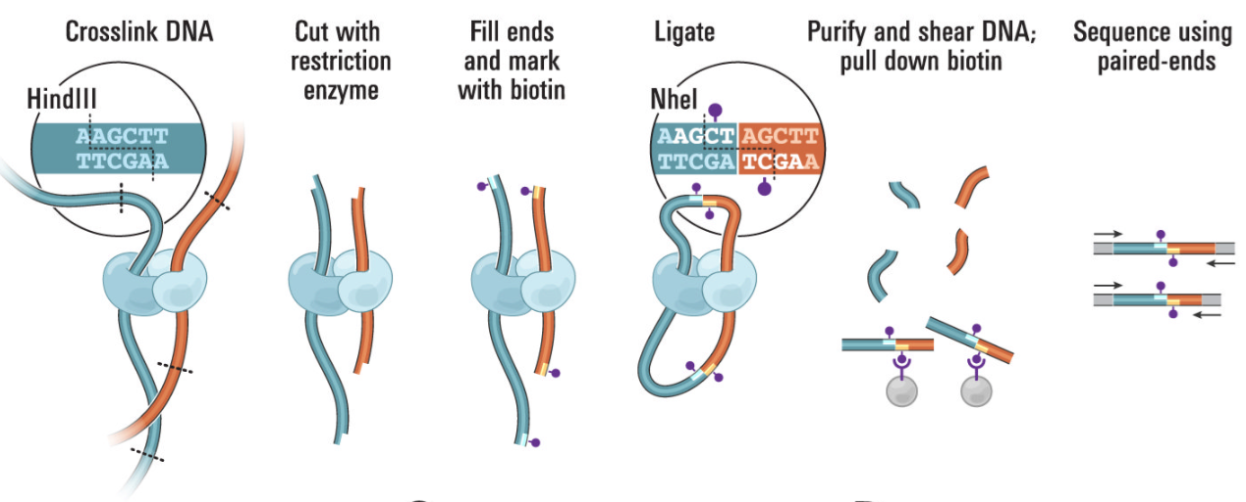
For the uninitiated…
Hi-C maps architectural features by sequencing crosslinked restriction fragments which were proximal in 3D space

Slide 3
Notes:
Female chr3L at 25kb bins

Slide 4
A note on Hi-C Resolution
Restriction sites
GATC
GATC
GATC
GATC
GATC
GATC
Genome
Restriction Digestion
Restriction Fragments
7 Fragments = 49 possible interactions
A Drosophila genome digested with HindIII = 65,978 fragments
OR
65,978 fragments = 4,353,096,484 possible interactions

Slide 5
Hi-C sequencing depth is on the rise

Slide 6
Simple representation

Slide 7
About the Data store
Binary HDF file.
Layers include:
Groups for Matrices, ex. Matrices/chr1/chr2/<matrix>
HiC data is stored as 2 dimensional matrices.
Groups for Ranges and respective metadata cols.
Groups for dataset metadata, ex. for filtering statistics, proj specific header information.
Using the Big family of functions to speed up processes.

Slide 8
What methods does HiCLegos offer?
Point selection
Select diagonals
Select sub matrix

Slide 9
How fast is HiCLegos?
Data storage
Data retrieval

Slide 10
Domain calling within HiCLegos
Directionality Index by Dixon et al., 2012

Slide 11
TAD Calling with HiCLegos is fast and accurate
Hi-C simulations as described in diffHiC

Slide 12
Plotting functions
HiCLegos will offer geoms and scales integrating with ggplot.
Separate geoms for domain boundaries, pixels and highlighted regions.
Using Bigmatrix to integrate with shinyR to provide interactive graphs.
Work In Progress

Slide 13
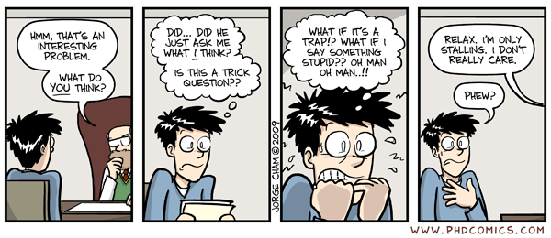
Acknowledgements
Graduating Dec 2018
Computational Genomics group @ IFOM
Francesco Ferrari (Principal investigator)
Carmen Livi
Endre Sebestyen
E-mail: koustav.pal@ifom.eu
Tweet @3DGenome_KPal

